Slide 1
Operating System Structure
Hamid R. Zarandi
h_zarandi@aut.ac.ir

Slide 2
Advantages of OS
Different views from OS
Services (predefined comfort routines)
Interface to users and programs (interactions)
Components & their interconnects (SW architecture)

Slide 3
OS services (helpful to users)
User interface
CLI (Command-line interface)
GUI (Graphical user interface)
Batch (shell script)
Program execution
I/O operations
File-system manipulation
Communications
Shared memory
Message passing
Error detection

Slide 4
OS services (for efficient operation)
Resource allocation
Accounting
Protection & security

Slide 5
OS interface (command line)
Command interpreters
Kernel-based vs. system program (Win, UNIX)
Multiple interpreters, shell
UNIX, Linux shells: Bourne shell, C shell, Bourne-Again shell, Korn shell
Third party shell!
Similar functionality, user preference
Shell implementations
Internal codes (make jump)
System programs (UNIX)
rm file.txt
Bourne shell in Solaris 10

Slide 6
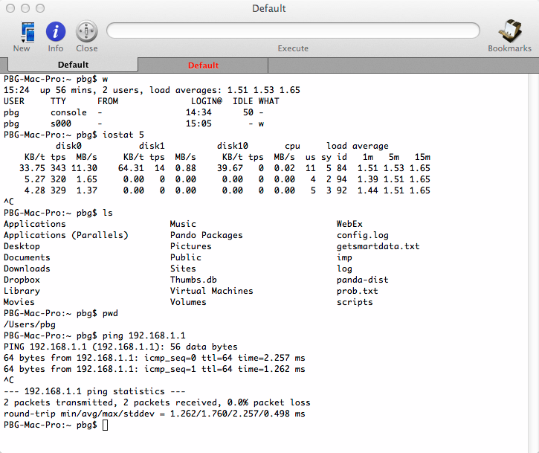
Bourne Shell command interpreter

Slide 7
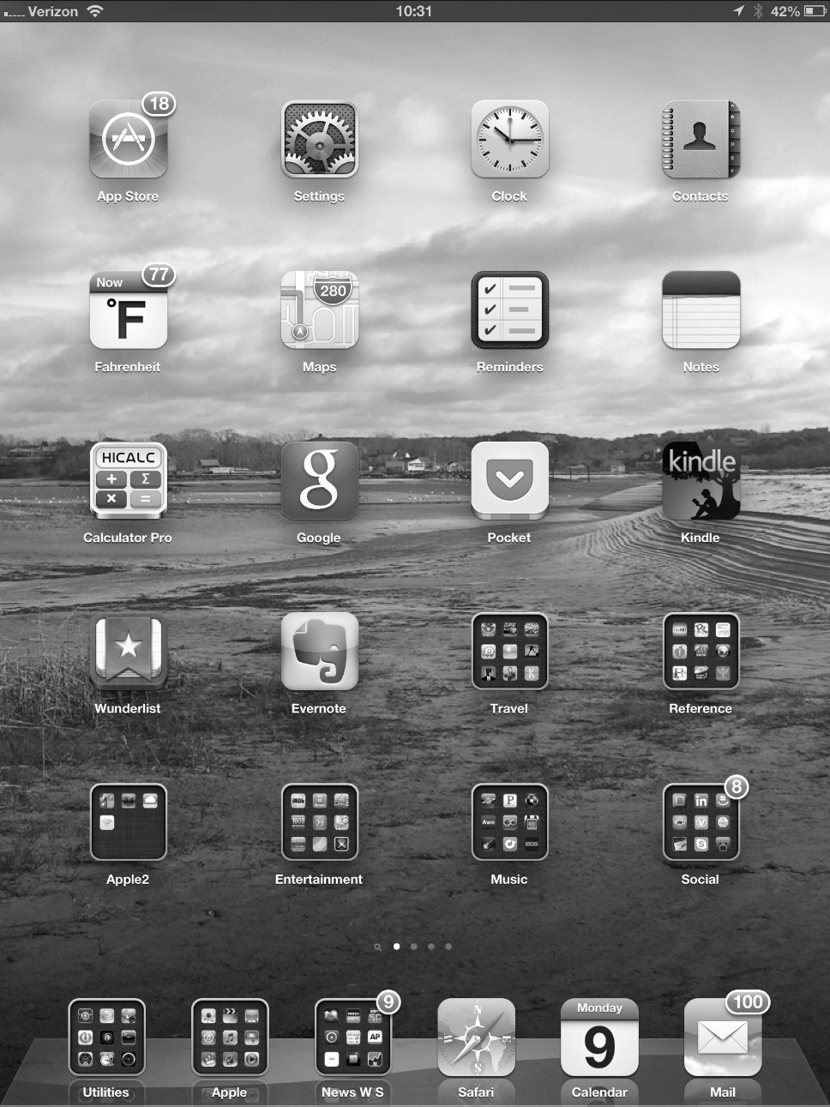
OS interface (GUI)
Xerox PARC (1970)
Xerox Alto (1973)
Apple Macintosh (1980)
Aqua in Mac OS X
Microsoft Windows
UNIX
CDE (Common desktop environment)
X-Windows
KDE (K Desktop environment)
GNOME (GNU project)

Slide 8
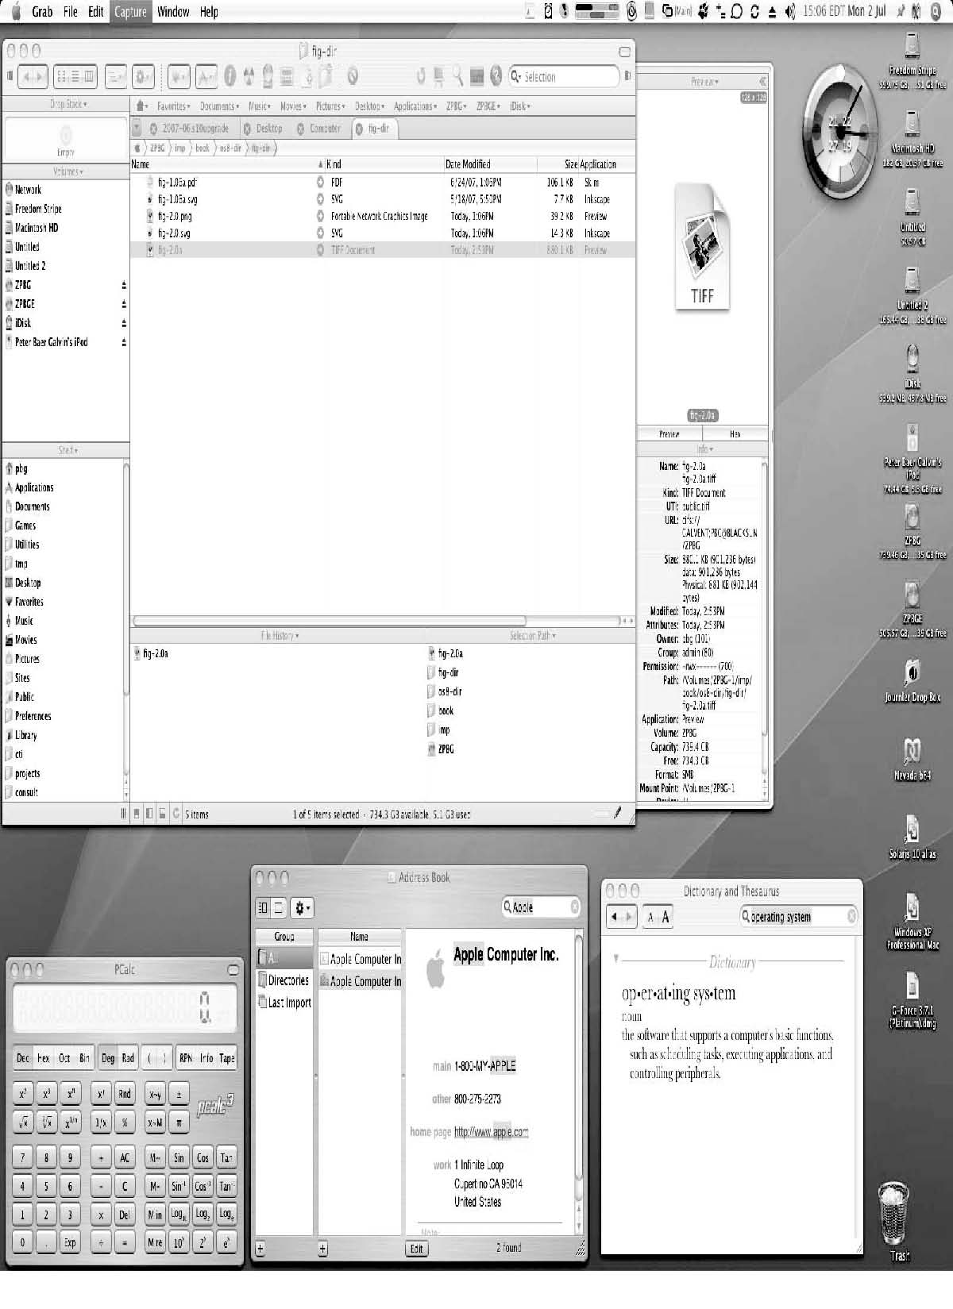
Choice of interface (The Mac OS X GUI)

Slide 9
System calls
C, C++, Assembly
API (Application program interface)
Win API
POSIX API (UNIX, Linux, Mac OS X): libc
JAVA API
Example: Copy file

Slide 10
Example of standard API

Slide 11
System call interface
Parameter passing
Register
Register pointer to mem. block
Stack (PUSH, POP)

Slide 12
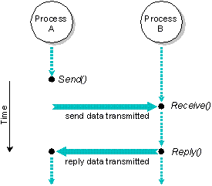
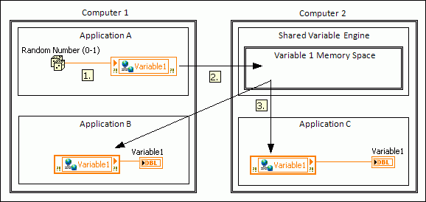
Communications mechanisms
Message passing
Easy
Suitable for low communication rate
No interference
Shared memory
Easy
Fast
Points of: protection, race condition

Slide 13
Types of system calls
Process control
File manipulation
Device manipulation
Information maintenance
Communications
Protections

Slide 14
Example of standard C library

Slide 15
Example: MS-DOS
Single-tasking
Shell invoked when system booted
Simple method to run program
No process created
Single memory space
Loads program into memory, overwriting all but the kernel
Program exit -> shell reloaded

Slide 16
Example: FreeBSD
Unix variant
Multitasking
User login -> invoke user’s choice of shell
Shell executes fork() system call to create process
Executes exec() to load program into process
Shell waits for process to terminate or continues with user commands
Process exits with code of 0 – no error or > 0 – error code

Slide 17
OS design & implementation
Goals
User vs. System
Mechanisms & policy
how vs. what
Implementation
Assembly, C or C++
MCP: ALGOL
MULTICS: PL/1
Linux, Win: C, Assembly
C is supported on diff. ISAs, CPUs

Slide 18
OS structure: 1. Simple structure (Monolithic)
The most common organization
OS is a single large program in kernel mode
Problems
Crash in called procedures?
Unwieldy & difficult to understand
A simple structuring model for a monolithic system

Slide 19
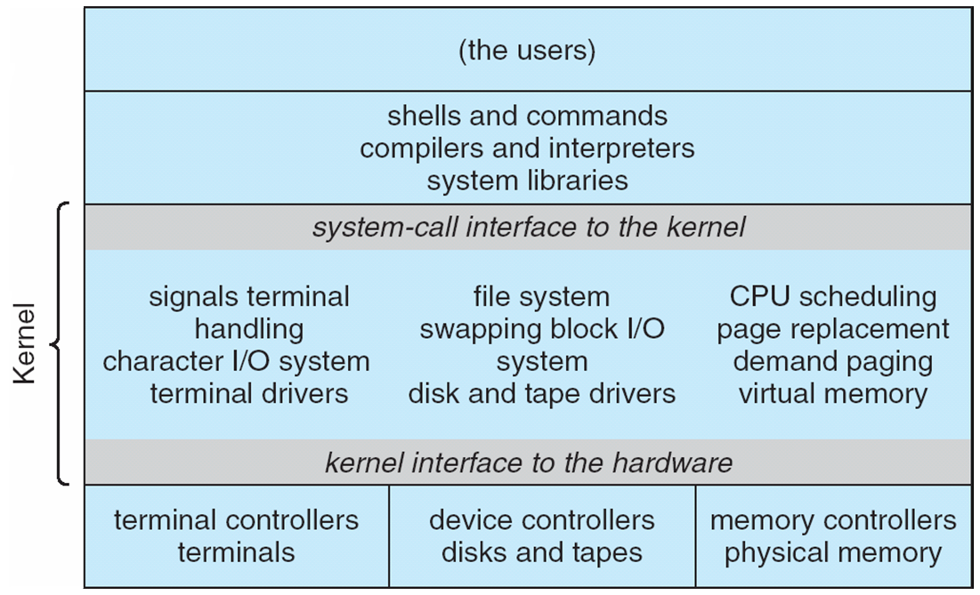
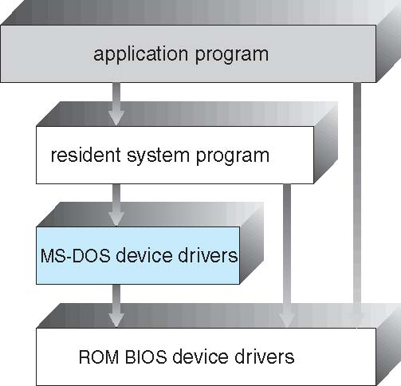
Samples
Simple structure
MS-DOS, UNIX (Traditional)
Beyond simple but not fully layered

Slide 20
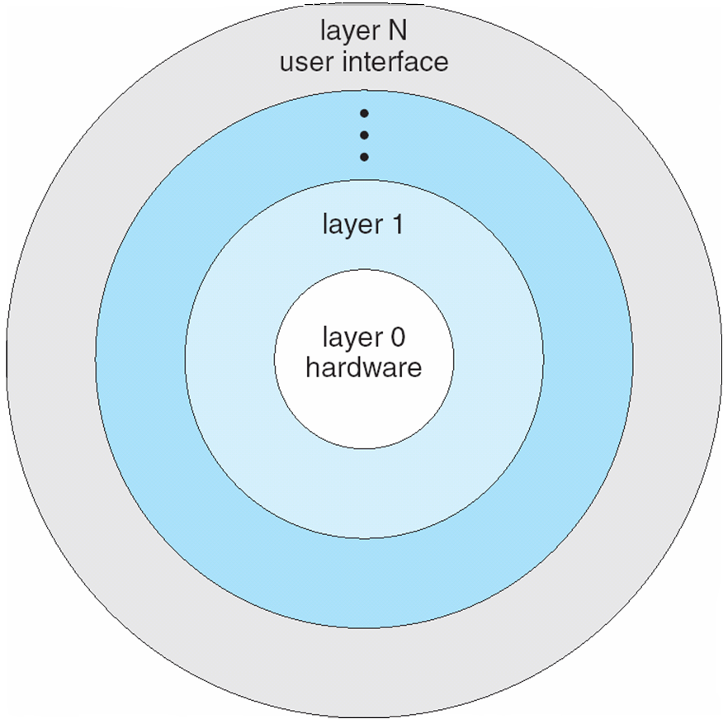
OS structure: 2. Layered approach
Layered approach
abstractions
adv.
Simplicity
Construction
Debugging
Functions and operations of low layers
dis. adv.
Layer definition problem
MMU, backing store, scheduler (?)
Less efficient

Slide 21
OS structure: 3. Microkernel
Microkernel
Moves as much from the kernel into “user” space
Communication takes place between user modules using message passing
Examples
Mach (CMU)
Mac OS X kernel (Darwin)
Benefits:
Easier to extend a microkernel
Easier to port the operating system to new architectures
More reliable (less code is running in kernel mode)
More secure
Detriments:
Performance overhead of user space to kernel space communication
Windows NT 4 (microkernel) slow!
vs. Windows XP (monolithic) fast!

Slide 22
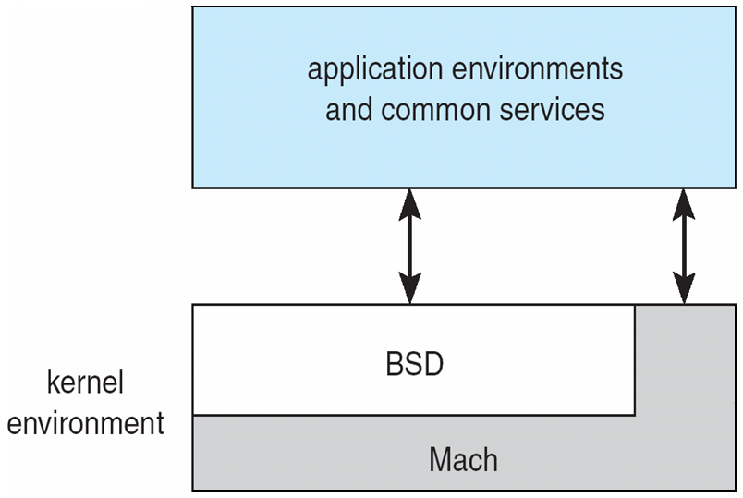
Mac OS X structure

Slide 23
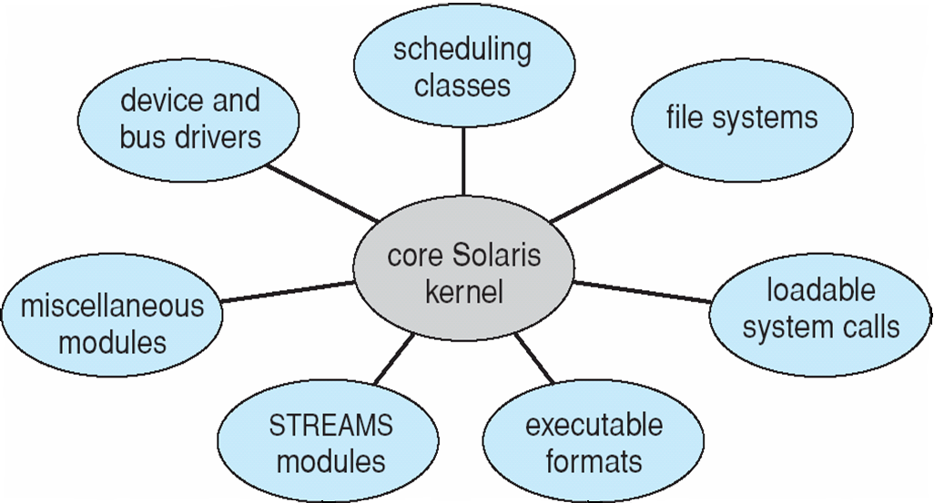
OS structure: 4. Modules
Modules
Most modern operating systems implement kernel modules
Uses object-oriented approach
Each core component is separate
Each talks to the others over known interfaces
Each is loadable as needed within the kernel
Faster than microkernel
No need of message passing
Better than layered
Direct module communications
Overall, similar to layers but with more flexible
Linux, Solaris, etc

Slide 24
Modern Unix kernel

Slide 25
OS structure: 5. Hybrid
Hybrid systems
Most modern operating systems
Mac OS
iOS
Android
Better to address
Reliability
Security
Usability
Examples
Linux & Solaris
kernel: monolithic
+feature: loadable
Windows
monolithic+microkernel

Slide 26
Mac OS X structure
Top is layered
Below is kernel consisting of Mach microkernel and BSD Unix parts, plus I/O kit and dynamically loadable modules (called kernel extensions)

Slide 27
iOS
Apple mobile OS for iPhone, iPad
Structured on Mac OS X, added functionality
Does not run OS X applications natively
Also runs on different CPU architecture (ARM vs. Intel)
Cocoa Touch Objective-C API for developing apps
Media services layer for graphics, audio, video
Core services provides cloud computing, databases
Core operating system, based on Mac OS X kernel

Slide 28
Android
Developed by Open Handset Alliance (mostly Google)
Open Source
Similar stack to IOS
Based on Linux kernel but modified
Provides process, memory, device-driver management
Adds power management
Runtime environment includes core set of libraries and Dalvik virtual machine
Apps developed in Java plus Android API
Java class files compiled to Java bytecode then translated to executable than runs in Dalvik VM
Libraries include frameworks for web browser (webkit), database (SQLite), multimedia, smaller libc

Slide 29
Android SW architecture (detail)

Slide 30
Android sys. architecture

Slide 31
Windows internal architecture

Slide 32
Linux kernel components

Slide 33
OS debugging
Debugging is finding and fixing errors, or bugs
OSes generate log files containing error information
Failure of an application can generate core dump file capturing memory of the process
Operating system failure can generate crash dump file containing kernel memory
Beyond crashes, performance tuning can optimize system performance
Kernighan’s Law: “Debugging is twice as hard as writing the code in the first place. Therefore, if you write the code as cleverly as possible, you are, by definition, not smart enough to debug it.”
DTrace tool in Solaris, FreeBSD, Mac OS X allows live instrumentation on production systems
Probes fire when code is executed, capturing state data and sending it to consumers of those probes

Slide 34
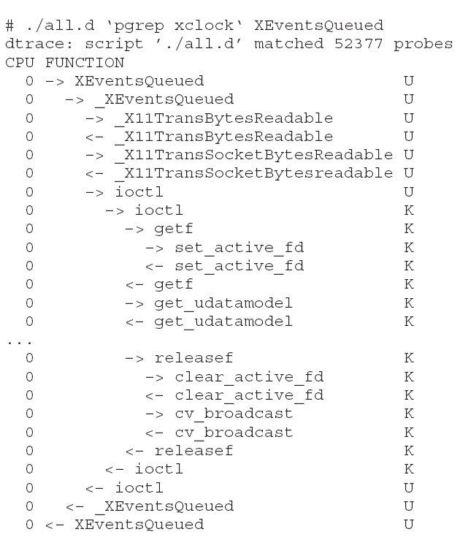
Solaris 10 dtrace Following System Call

Slide 35

Questions?

